Slide 1
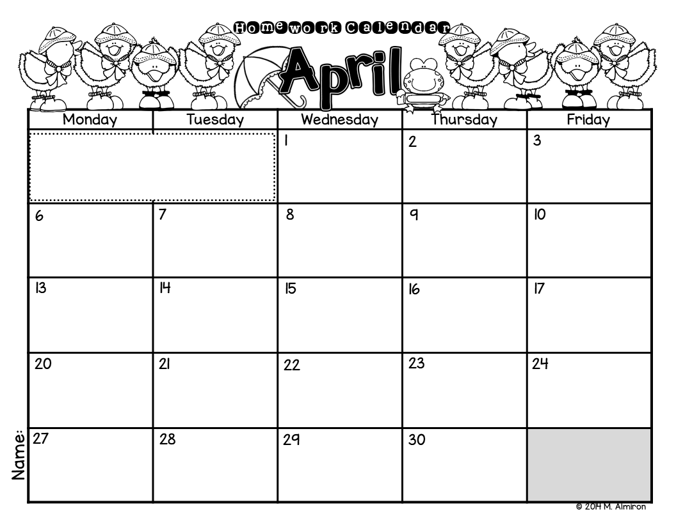
Please color the boxes as you complete each activity.
Don’t forget to read for 20 minutes every night!
Write a joke, or something funny.
What is your favorite thing to do when it rains? Write and illustrate.
Why is rain important? Write to explain.
Do you like rainy days? Why or why not? Write to explain.
Write a subtraction sentence
(i.e.: 5 - 2 = 3). Draw objects to represent.
Write to describe a bunny. Illustrate.
Write all the words you can think that end with “g”.
Write a list of words from the “_ing” family.
Draw a colorful garden. Label your picture.
Write a list of things you would like to plant in your garden.
Circle all the sight words you know in a newspaper or magazine.
Write a list of things you can reuse.
Write a list of things you can reduce.
Write a list of things you can recycle.
How can you save electricity? Write and illustrate.
Draw the Earth. Write what you can do to help our planet.
Write 3 sentences using sight words.
Write a subtraction sentence
(i.e.: 5 - 2 = 3). Draw objects to represent.
Write a list of things that grow on trees.
How can you help trees? Write and illustrate.
Draw and write about something you wish it would grow on trees (use your imagination).
What is your favorite thing about trees? Write and illustrate.

